Slide 1
Lesson 11 – Input and Output

Slide 2
Plan
IO, NIO/NIO2
Resource Management
Serialization
Encodings

Slide 3
Java IO basically provides a mechanism to read data from a source and write data to a destination.

Slide 4
IO Evolution
1996
2002
2011
2020
IO
NIO
NIO2

Slide 5
IO Blocking Input/Output

Slide 6
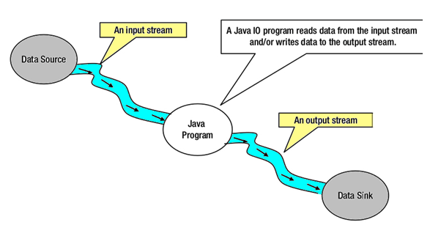
Blocking IO – java.net.*
Stream - a continuous flow of data (bytes, chars, objects)

Slide 7
Built-in streams
System.in
System.err
System.out

Slide 8
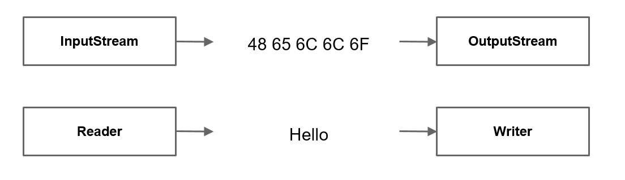
Stream types
By direction
Input
Output
By content
Bytes
Characters

Slide 9
InputStream
int read() / read(…)
void close()
boolean markSupported()
void mark(readLimit) / reset()
long skip(n)
int available()

Slide 10
OutputStream
write(byte bytes[]) / write(…)
flush()
close()

Slide 11
InputStream/OutputStream
InputStream in = new FileInputStream(source); OutputStream out = new FileOutputStream(destination) int byteRead; while((byteRead = in.read()) != -1) { out.write(byteRead); }

Slide 12
Reader/Writer
Reader reader = new FileReader(source); Writer writer = new FileWriter(destination); int charRead; while ((charRead = reader.read()) > -1) { writer.write(charRead); }

Slide 13
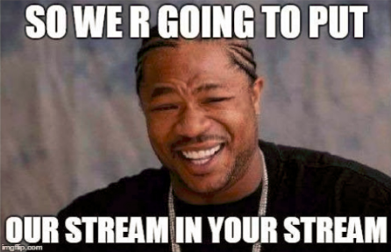
Stream types
By abstraction level
Low
High
FileInputStream fis = new FileInputStream(“file.dat"); BufferedInputStream bfis = new BufferedInputStream(fis); ObjectInputStream objectStream = new ObjectInputStream(bfis);

Slide 14
Stream types
Name | Level | Description
FileInputStream | Low | Reads file data as bytes
FileOutputStream | Low | Writes file data as bytes
FileReader | Low | Reads file data as characters
FileWriter | Low | Writes file data as characters
BufferedReader | High | Reads character data from an existing Reader in a buffered manner
BufferedWriter | High | Writes character data to an existing Writer in a buffered manner
ObjectInputStream | High | Deserializes primitive Java data types and graphs of Java objects from an existing InputStream
ObjectOutputStream | High | Serializes primitive Java data types and graphs of Java objects to an existing OutputStream
InputStreamReader | High | Reads character data from an existing InputStream
OutputStreamWriter | High | Writes character data to an existing OutputStream
PrintStream | High | Writes formatted representations of Java objects to a binary stream
PrintWriter | High | Writes formatted representations of Java objects to a text-based output stream

Slide 15
Input / Output
File – bytes java.exe, movie.mp4, …
Directory - bytes c:/Program Files/Java, /home, …
Root directory - c:/, /
Path – string representation /user/home/zoo.txt, video/fun.3gp, …

Slide 16
File
java.io.File
directories as well as files
Does not require file existence for instantiation of File class
Types:
Relative - new File(“temp/taxiPark.db");
Absolute - new File("/temp/taxiPark.db");

Slide 17
File
exists()
getName()
getParent()
getAbsolutePath()
isDirectory(), isFile()
length()
lastModified()
delete()
renameTo(File)
mkdir(), mkdirs()
listFiles()

Slide 18
File
File file = new File("/temp/taxiPark.db"); print("File Exists: " + file.exists()); if (file.exists()) { print("Absolute Path: " + file.getAbsolutePath()); print("Parent Path: " + file.getParent()); if (file.isFile()) { print("File size: " + file.length()); print("File Last Modified: " + file.lastModified()); } else { print("Traversing Directory"); for (File subfile : file.listFiles()) { print("\t" + subfile.getName()); } } }

Slide 19
NIO / NIO2 Non-Blocking (New) IO

Slide 20
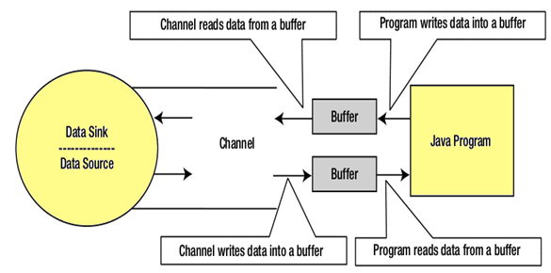
Non-blocking IO – java.nio.*

Slide 21
Non-blocking IO2 – java.nio.*
java.nio.file.Path – interface
Immutable (thread safe)
full support for symbolic links (unlike the File)
java.nio.files.Paths
Does not require file existence for creation of Path object
Path path = Paths.get(“/home/video/movie.mp4");

Slide 22
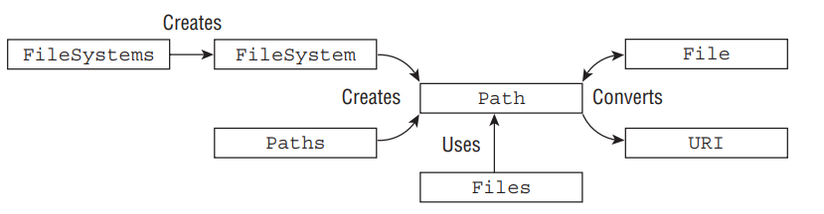
Non-blocking IO2 – java.nio.*

Slide 23
Names hierarchy
Path songPath = Paths.get("\\home\\video\\..\\audio\\song.flac"); print(songPath); // \home\video\..\audio\song.flac print(songPath.getParent()); // \home\video\..\audio Path normalized = songPath.normalize(); print(normalized); // \home\audio\song.flac print(normalized.getParent()); // \home\audio Path absolute = normalized.toAbsolutePath(); print(absolute); // \home\audio\song.flac print(absolute.getRoot()); // \ print(absolute.getNameCount()); // 3 print(absolute.getFileName()); // song.flac print(absolute.getName(0)); // home print(absolute.subpath(1, 3)); // audio\song.flac

Slide 24
Relativize, resolve
Path path1 = Paths.get("C:\\Windows"); Path path2 = Paths.get("C:\\Program Piles\\JetBrains"); Path path3 = Paths.get("JetBrains"); println(path1.relativize(path2)); // ..\Program Piles\JetBrains println(path2.relativize(path1)); // ..\..\Windows println(path2.relativize(path3)); // Exception! Path path4 = Paths.get("IntelliJ IDEA"); println(path2.resolve(path4)); // C:\Program Piles\JetBrains\IntelliJ IDEA println(path1.resolve(path2)); // C:\Program Piles\JetBrains

Slide 25
Interacting with Files
Path idea = Paths.get("\\Program Files\\JetBrains\\IntelliJ IDEA 2020.1"); Path currentDir = Paths.get("."); // \ Files.exists(idea); // true Files.isDirectory(idea); // true Files.isSameFile(idea, idea.resolve("bin\\..")); // true Files.isSameFile(idea, currentDir); // false Path newIdea = idea.resolveSibling(Paths.get("IntelliJ IDEA 2020.2")); Files.exists(newIdea); // false Files.createDirectories(newIdea); // c:\Program Files\JetBrains\IntelliJ IDEA 2020.2 Files.exists(newIdea); // true

Slide 26
Interacting with Files. Copy, move
Path fun = Paths.get("\\video\\fun.3gp"); Path moreFun = Paths.get("\\video\\moreFun.3gp"); Path moreMoreFun = Paths.get("\\video\\moreMoreFun.3gp"); Files.exists(fun); // true Files.exists(moreFun); // false Files.exists(moreMoreFun); // false Files.copy(fun, moreFun); // shallow copy Files.exists(moreFun); // true Files.exists(moreMoreFun); // false Files.move(fun, moreMoreFun, REPLACE_EXISTING); // shallow movement

Slide 27
Interacting with Files. Delete
Files.delete(fun); // delete
Files.deleteIfExists(fun); // silent delete Files.delete(moreFun); // deleted Files.delete(moreMoreFun); // deleted
Files.exists(fun); // false Files.exists(moreFun); // false Files.exists(moreMoreFun); // false

Slide 28
File Attributes
Path file = Paths.get("\\video\\fun.3gp"); Files.isDirectory(file); // false Files.isHidden(file); // false Files.isReadable(file); // true Files.isExecutable(file); // true Files.isSymbolicLink(file); // false Files.getLastModifiedTime(file); // 2020-12-25T19:43:24.118632Z Files.size(file); // 13

Slide 29
Files search folder content
Files.list(idea).forEach(c::println);
Files.walk(idea, 1).forEach(c::println); // DFS
Files.find(
idea,
1,
(p,a) -> p.startsWith("bin")
).forEach(c::println);

Slide 30
Resources Management

Slide 31
Resources Management
Flushable::flush – trigger data write event if cached
Closeable::close - handles closing a resource (source or destination).
AutoCloseable::close – handles closing a resource (source or destination). Automatically invoked by try-with-resorces

Slide 32
Automatic Resource Management
void copy(File source, File destination) { InputStream in = null; OutputStream out = null;
try { in = new FileInputStream(source); out = new FileOutputStream(destination); int bytesRead; while ((bytesRead = in.read()) != -1) { out.write(bytesRead); } } catch (IOException e) { log.error("Copying failed", e); } finally { close(in); close(out); } }
void close(Closeable resource) { if(nonNull(resource)) { try { resource.close(); } catch (IOException e) { log.error("Close failed", e); } } }

Slide 33
Automatic Resource Management
void copy(File source, File destination) { try (InputStream in = new FileInputStream(source); OutputStream out = new FileOutputStream(destination) ) { int bytesRead; while ((bytesRead = in.read()) != -1) { out.write(bytesRead); } } catch (IOException e) { logger.error("Copying failed", e); } }

Slide 34
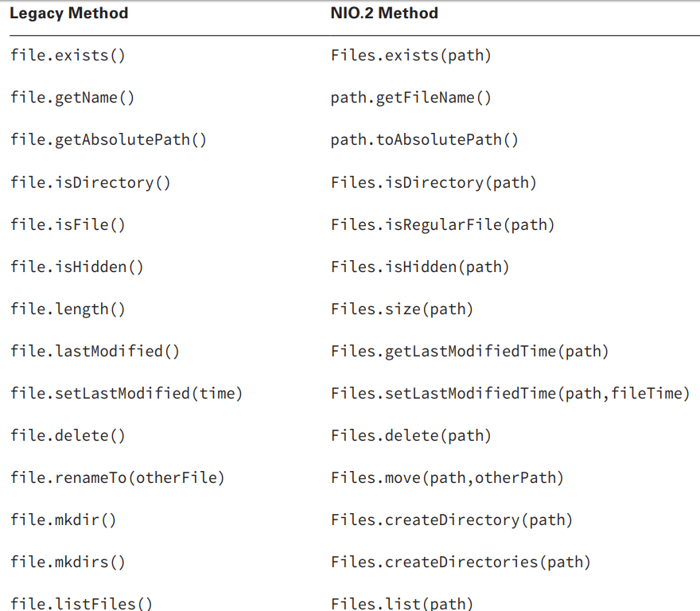
IO vs NIO/2

Slide 35
Data serialization

Slide 36
Data serialization\deserialization
Implement the java.io.Serializable interface
Add serialVersionUID
FileInputStream fis = new FileInputStream(historyFile); BufferedInputStream bis = new BufferedInputStream(fis); ObjectInputStream in = new ObjectInputStream(bis); Object object = in.readObject(); if (object instanceof History) { return (History) object; }

Slide 37
Charsets, Encoding

Slide 38
Encoding
ѓ« ў-л© ‚®Їа®б †Ё§-Ё, ‚бҐ«Ґ--®© Ё ‚бҐЈ®-ўбҐЈ®
Win-1251
UTF-8
ISO-8859-5
…
java.nio.charset.Charset
java.nio.charset.StandardCharsets

Slide 39
Read and Write text files with NIO2
Path src = Paths.get("/source.txt"); Path dest = Paths.get("/destination.txt"); BufferedReader reader = Files.newBufferedReader(src, US_ASCII); BufferedWriter writer = Files.newBufferedWriter(dest, UTF_8) String currentLine; while ((currentLine = reader.readLine()) != null) { writer.write(currentLine); } reader.close(); writer.close();

Slide 40
Homework
Implement persisting of students list into file (read and write. Any file encoding format is allowed). When program is started, it should search file “Students.dat” in a user home directory, and if such file is found read all records. Then usual flow of reading\generating “n” new students and printing analytics over all students (aggregated both: from file and new). In the end – persist all students list to file. If expected students file size is more than 1 Megabyte, file should be overridden with only new students (entered in runtime). When only new students size > 1MB – return an error;
Add Ukrainian 12-score grade support;
Cover entire StudentsRegistry app by tests up to 80%.

Slide 41
Links
IO/NIO - Oracle
IO/NIO - Developers Zone
IO/NIO - Tutorialspoint

Slide 42
Thanks!
Any Questions?
Or find us in Slack:
@Yaroslav Brahinets
@Vasya Rudas

Slide 43


